Slide 1
EXT2 File System – Part 1
CptS 360 Systems Programming
School of Electrical Engineering and Computer Science
Washington State University
Hassan Ghasemzadeh (hassan.ghasemzadeh@wsu.edu)

Slide 2
Topics
Introduction to EXT2 file system
EXT2 file system data structures

Slide 3
Introduction to EXT2

Slide 4
Introduction to EXT2 file system
EXT2 (second extended file system) initially designed by Remy Card [1995] as a replacement for extended file system (EXT)
EXT2 was the default filesystem in several Linux distributions (Debian, Red Hat) until replaced by EXT3
EXT3 is compatible with EXT2 but note that EXT3 is a journaling file system
A journaling file system keeps track of changes not yet committed to file system by recording intentions changes in a data structure known as a "journal“ (e.g., a circular buffer)
Upon crash or power failure, file system can be brought back online more quickly with a lower likelihood of becoming corrupted

Slide 5
Introduction to EXT2 file system (cont.)
EXT2 is used for flash-based storage media (e.g., SD cards and USB flash drives)
No journaling means higher performance and less writes to the device
Also, flash devices can endure only a limited number of write cycles
EXT4 is the newest extension [Cao et al. 2007]
Allocation of disk blocks was introduced in EXT4
Instead of discrete disk blocks, EXT4 allocates contiguous ranges of disk blocks, called extents
Our focus will be EXT2

Slide 6
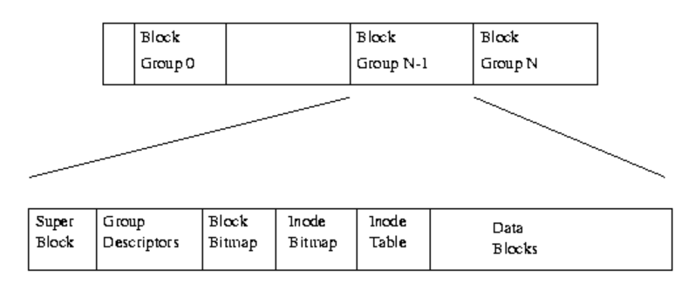
EXT2
EXT2 can be views as a series of blocks in a block structured device
EXT2 divides logical partition that it occupies into Block Groups
https://tldp.org/LDP/tlk/fs/filesystem.html

Slide 7
EXT2 file system creation
To create an EXT2 file system, one can use the following Linux command:
mke2fs [-b blksize -N ninodes] device nblocks
This creates an EXT2 ﬁle system on a ‘device’ with ‘nblocks’ blocks of ‘blksize’ bytes and ‘ninodes’ inodes
‘device’ can be a real device or a virtual device/disk
Default blksize is 1 KB
Default ninoides is computed based on nblocks

Slide 8
EXT2 Data Structures

Slide 9

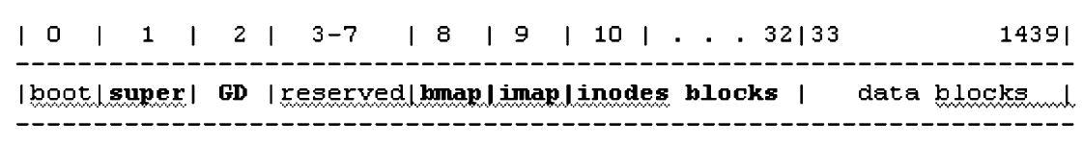
EXT2 file system creation example
Consider the following commands
This creates a virtual disk (by copying ‘all NULL’ data into a new file, ‘vdisk’)
The new disk (vdisk) contains 1440 blocks each of which is 1024 bytes all filled with NULL values.
This creates an EXT2 file system on ‘vdisk’ with 1440 blocks of 1 KB
Disk layout
How does the layout look like for the above-created disk?

Slide 10
Disk Boot Block (Block#0 or B0)
Block#0 is also called boot block
B0 is not used by ﬁle system
Boot block contains a booter program for booting up an operating system from disk

Slide 11
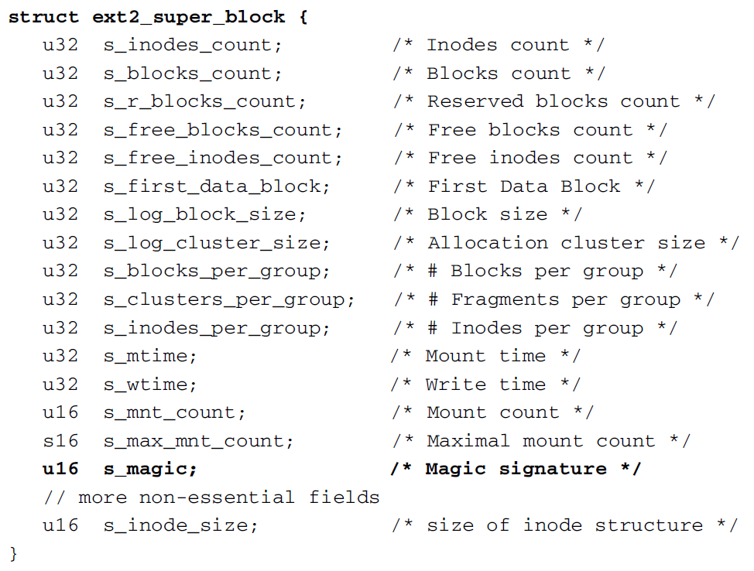
Superblock (Block #1 or B1)
Superblock is located at byte offset 1024 in hard disk partitions
Superblock contains information about entire ﬁle system
Some of the important ﬁelds are shown here

Slide 12
Superblock data fields
s_ﬁrst_data_block is used to determine the start block of group descriptors
s_ﬁrst_data_block=0 for 4KB block size
s_ﬁrst_data_block=1 for 1KB block size
start block of group descriptors = s_ﬁrst_data_block + 1
s_log_block_size is used to compute ﬁle block size
s_log_block_size=0 for 1KB files
s_log_block_size=1 for 2KB files
s_log_block_size=2 for 4KB files
file size = 1KB × (2^s_log_block_size)
s_mnt_count is number of times ﬁle system has been mounted
When mount count reaches max_mnt_count, fsck is forced to check for consistency
s_magic is magic number specifying ﬁle system type (0xEF53 for EXT2/3/4)

Slide 13

Superblock example
Write C program that displays superblock of an EXT2 ﬁle system
To compile and run programs that access EXT2, system must have the ext2fs.h header ﬁle installed
ext2fs.h deﬁnes data structures of EXT2/3/4 ﬁle systems
In Linux, we can get and install the ext2fs development package by

Slide 14
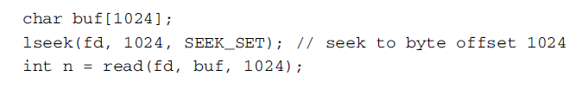
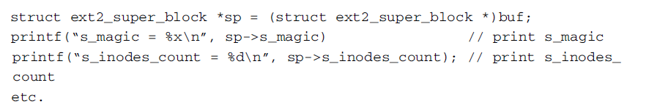
Superblock example (cont.)
Steps to display superblock
First, open disk (e.g., vdisk) for read
int fd=open(“vdisk”, O_RDONLY);
Next, read superblock (block #1 or 1 KB at offset 1024) into a char buf[1024]:
SEEK_SET: file offset is set to offset bytes
Next, let a struct ext2_super_block *sp point to buf[ ]
Finally, use sp→ﬁeld to access various ﬁelds of superblock

Slide 15
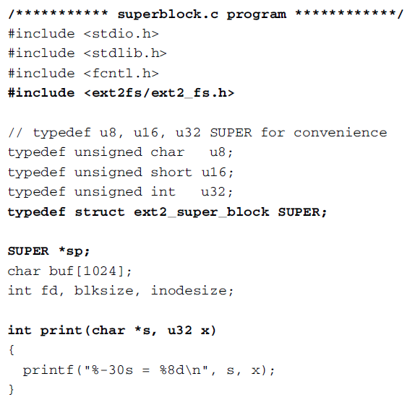
Superblock example (cont.)

Slide 16
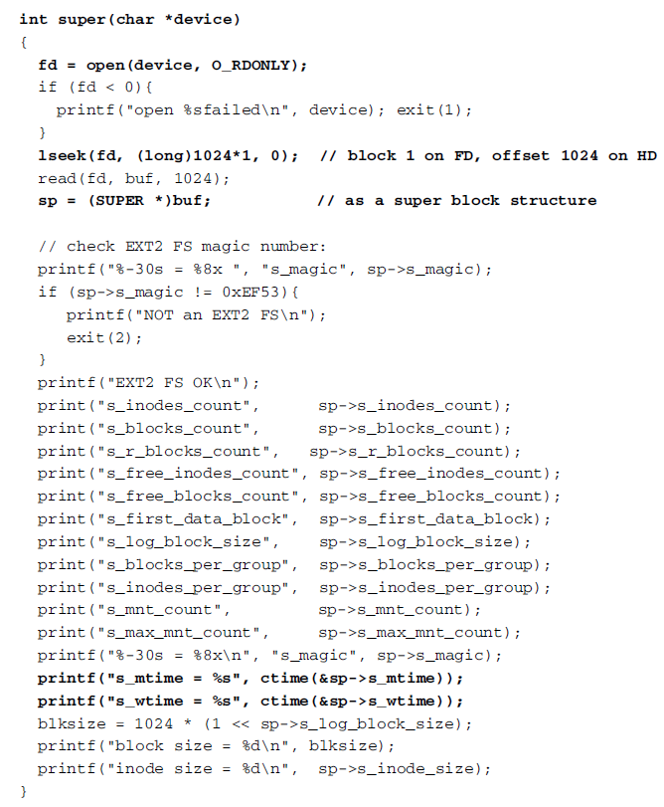
Superblock example (cont.)

Slide 17
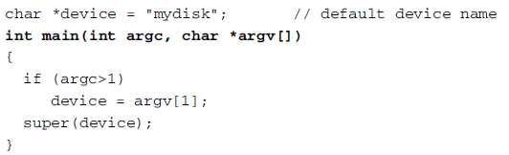
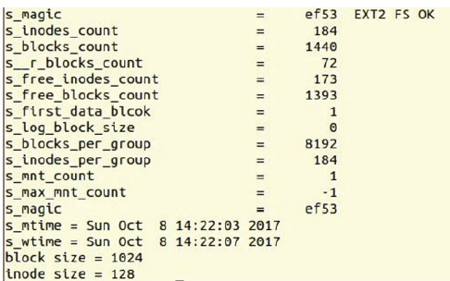
Superblock example (cont.)
Finally, the main() function will look like as follows
The program output looks like this

Slide 18
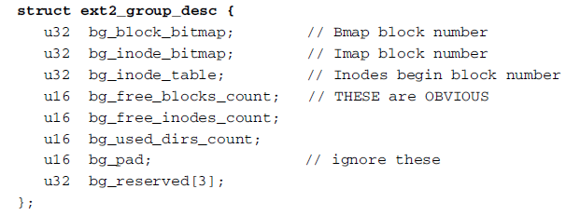
Group descriptors (Block #2 or B2)
GD is located at offset s_ﬁrst_data_block+1
EXT2 divides disk blocks into groups
Each group contains 8192 (32 K on HD) blocks
Each group is described by a group descriptor structure
follow this block number to find inode blocks
These two fields tell us where on disk to go to find the bmap or imap blocks

Slide 19
Group descriptors (cont.)
Important ﬁelds in GD are
bg_block_bitmap points to group’s blocks bitmap
bg_inode_bitmap points to group’s inodes bitmap
bg_inode_table points to group’s inodes start block
In Linux
bmap is located at offset block 8
imap is located at offset block 9
inode_table is located at offset block 10

Slide 20
Block bitmap (bmap, Block #8, or B8)
What is a bitmap?
a sequence of bits used to represent some kind of items, e.g., disk blocks or inodes
What is a bitmap used for?
A bitmap is used to allocate and deallocate items
A 0 bit means corresponding item is ‘free’
A 1 bit means corresponding item is ‘in_use’
Block bmap is denoted as ‘bg_block_bitmap’ in group descriptor structure
How many valid bits do we have in a bmap?
Our example disk has 1440 blocks, but B0 is not used by ﬁle system
bmap has only 1439 valid bits
Invalid bits are treated as ‘in_use’ and set to 1’s

Slide 21
Inode bitmap (imap, Block#9, or B9)
What is an inode?
An inode is a data structure used to represent a ﬁle
How many inodes do exist?
An EXT2 ﬁle system is created with a ﬁnite number of inodes
What is imap field and what is it used for?
Tells us what inodes are available for use
Status of each inode is represented by a bit in ‘imap’ in B9
‘imap’ is denoted as ‘bg_inode_bitmap’ in group descriptor structure
First 10 inodes are reserved
To this end, imap of an empty EXT2 file system starts with ten 1’s, followed by 0’s
Invalid bits are again set to 1’s

Slide 22
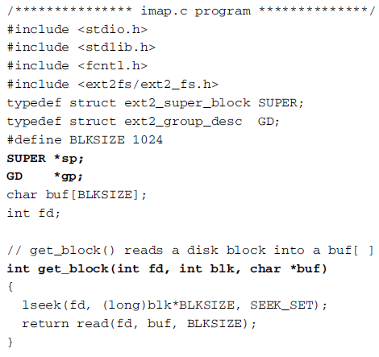
Inode bitmap example
Write C program to show inodes bitmap (imap) in HEX
datatype for superblock data structure
datatype for group descriptor data structure

Slide 23

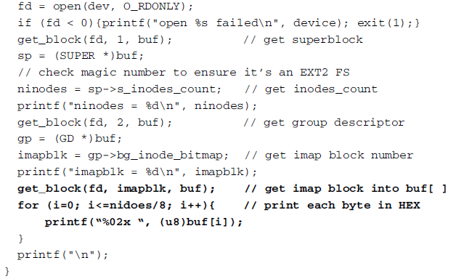
Inode bitmap example (cont.)
The imap() function can be written as follows
open the device in read mode
verify valid EXT2 (not included here)

Slide 24
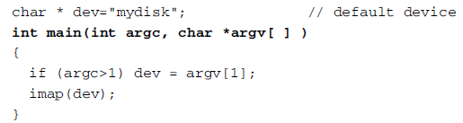
Inode bitmap example (cont.)
The main() function is given here:
Output looks like this
bitmap (convert to binary from hex and reversed ordered each byte)
What is the bitmap used for?

Slide 25
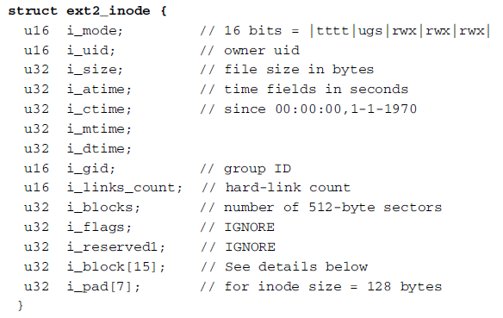
Inode
Before discussing inodes blocks, lets review what inodes do
Every ﬁle is represented by a unique inode structure of 128 bytes
The inode ﬁelds are listed below
inodes blocks maintain these data structures

Slide 26

Inode structure data ﬁelds
imode is an important field in the inode data structure
Leading 4 bits specify ﬁle type
‘tttt’=1000 for regular ﬁle
‘tttt’=0100 for directory
Next 3 bits (i.e., ‘ugs’) are for special use
Last 9 bits are ‘rwx’ permission bits
i_size is ﬁle size in bytes
time ﬁelds are number of seconds elapsed since 0 hr 0 min, 0 s of January 1, 1970
Use library function ctime() to convert them to calendar form

Slide 27
Inodes blocks (Block#10 or B10 and on)
Recall that indoes blocks can be accessed following bg_inode_table in the group descriptor data structure
i_block[15] (an array of size ‘15’) contains pointers to disk blocks of a ﬁle

Slide 28
Inodes blocks (cont.)
i_block[15] array contains pointers to disk blocks of a ﬁle
These disk blocks are
Direct blocks: i_block[0] to i_block[11] point to direct disk blocks
Indirect blocks: i_block[12] points to a disk block that contains 256 (for 1KB blocks) block numbers, each of which points to a disk block
Double Indirect blocks: i_block[13] points to a block, which points to 256 blocks, each of which points to 256 disk blocks
Triple Indirect blocks: i_block[14] is triple-indirect block.

Slide 29
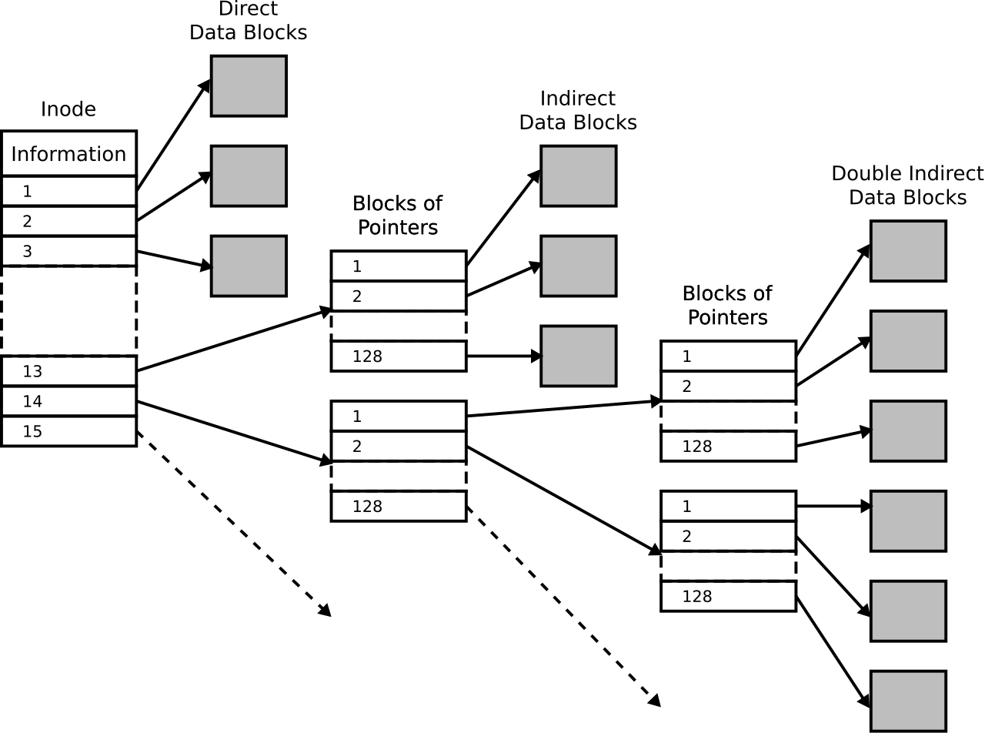
Direct vs. indirect data blocks
This figure illustrates the difference between direct data blocks and indirect data blocks
i_block
0
1
2
12
13
14
index
actual inode number

Slide 30
Inodes blocks (cont.)
Inode size (128 or 256) is designed to divides block size (1 KB or 4 KB) evenly, so that every inode block contains an integral number of inodes
Number of inodes is, by Linux default, 184 for EXT2
Number of inodes blocks is equal to 184/8 = 23 (thus, inodes blocks are B10 to B32)
Note that inode positions count from 0, but inode numbers count from 1.
A ‘0’ inode number means no inode
Root directory’s inode number is 2
Disk block numbers also count from 1 since block 0 is never used by a ﬁle system
A ‘0’ block number means no disk block.

Slide 31
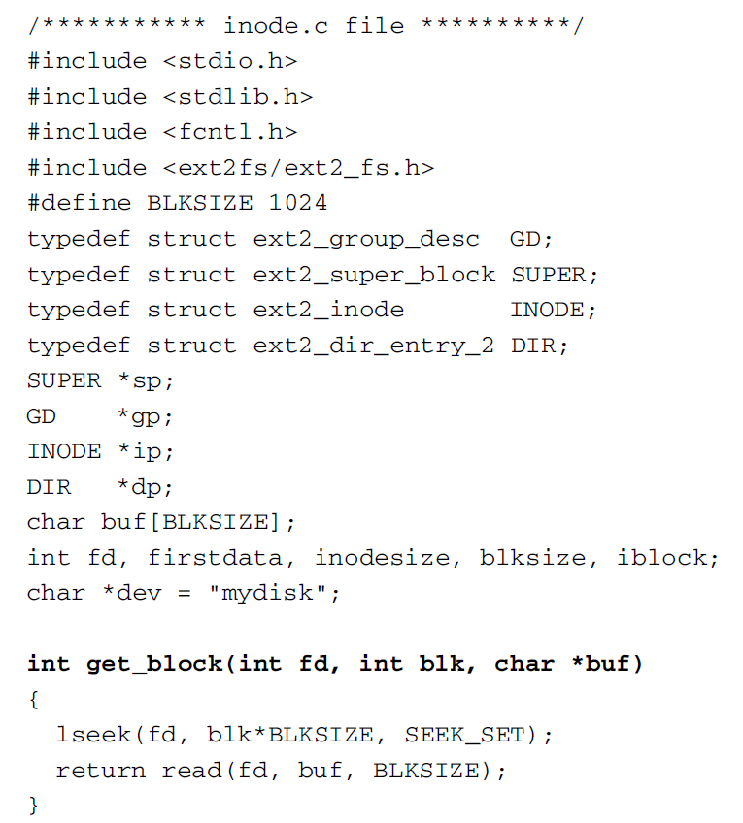
Example: inodes blocks
Write a C program to display indoe information of the root (‘/’) directory
We note number 2 inode is inode of root directory, “/”

Slide 32
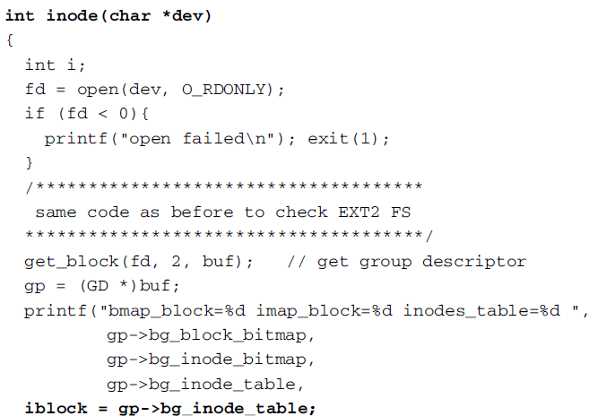
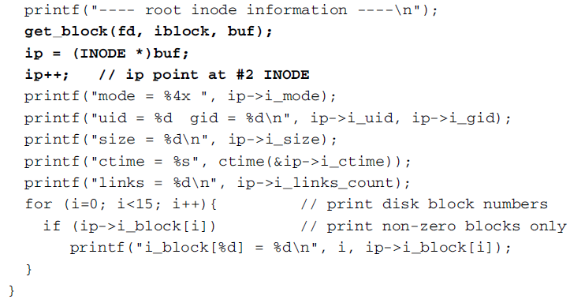
Example (cont.)
get the block number for start of inodes blocks

Slide 33
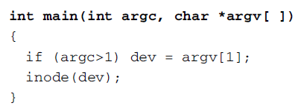
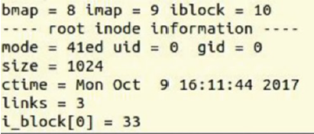
Example (cont.)
The main() function is given here.
The program output is shown below.
extracted from inode structure
data blocks that belong to this file
these data blocks are for example file names that are in / directory

Slide 34
Data blocks
Immediately after inodes blocks are data blocks
Data blocks store ﬁle contents
Assuming 184 inodes, ﬁrst real data block is B33, which is i_block[0] of the root directory “/” in our running example vdisk

Slide 35


Directory entries
A directory contains dir_entry structure (given below)
dir_entry is an open-ended structure
‘name’ varies in length, also does rec_len also
Contents of data block of a directory has this form
NAME is a sequence of name_len chars without a terminating NULL byte
Each dir_entry has a record length rec_len

Slide 36
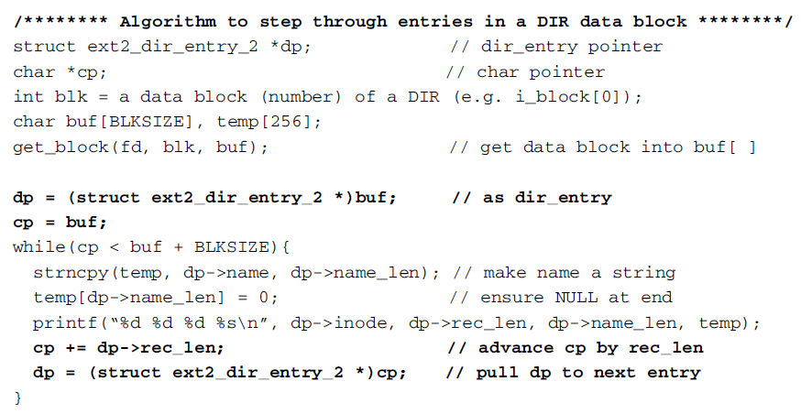
Navigating directory data block
How to step through the dir_entries in a directory data block?
content looks like
length is embedded in the entry

Slide 37
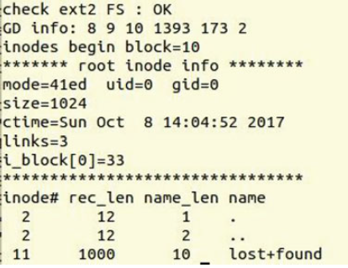
Example: directory entries
A program written to show directory entries for root directory will produce an output similar to the one given below
Note:
rec_len of the last entry in a block covers the remaining block length, i.e., from where the entry begins to the end of block

